Slide 1
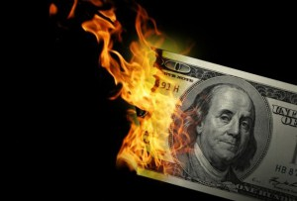
CS1951 L
Blockchains & Cryptocurrencies
Fall 2025
Lecture 14
Making Ethereum Scalable
Maurice Herlihy
Brown University

Slide 2
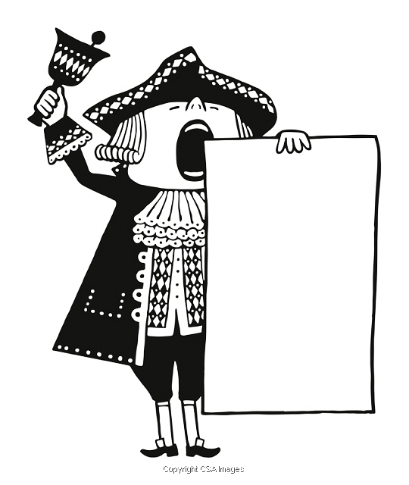
Announcement
This course will be taught next semester!
(Fall 2025)
next semester
We need UTAs!
Apply now -- Undergrad or Master’s
Yes, you are qualified
Questipns? Ask me or Jakobi

Slide 3
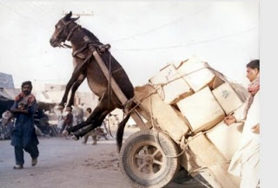
Ethereum isn’t Scaling Well
Transactions increasingly …
Take a long time
Cost more in fees

Slide 4
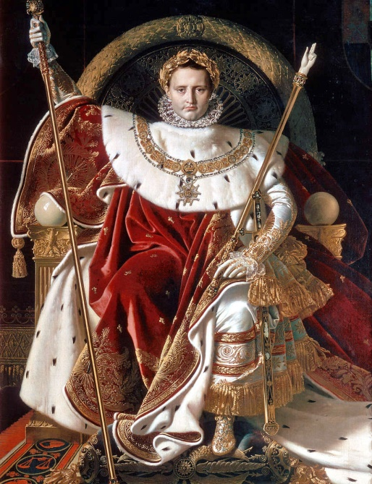
Ethereum is Becoming too Centralized
Validator nodes are expensive
Must stake at least 32 ether (> $40K)
Most nodes owned by small number of whales and crypto exchanges

Slide 5
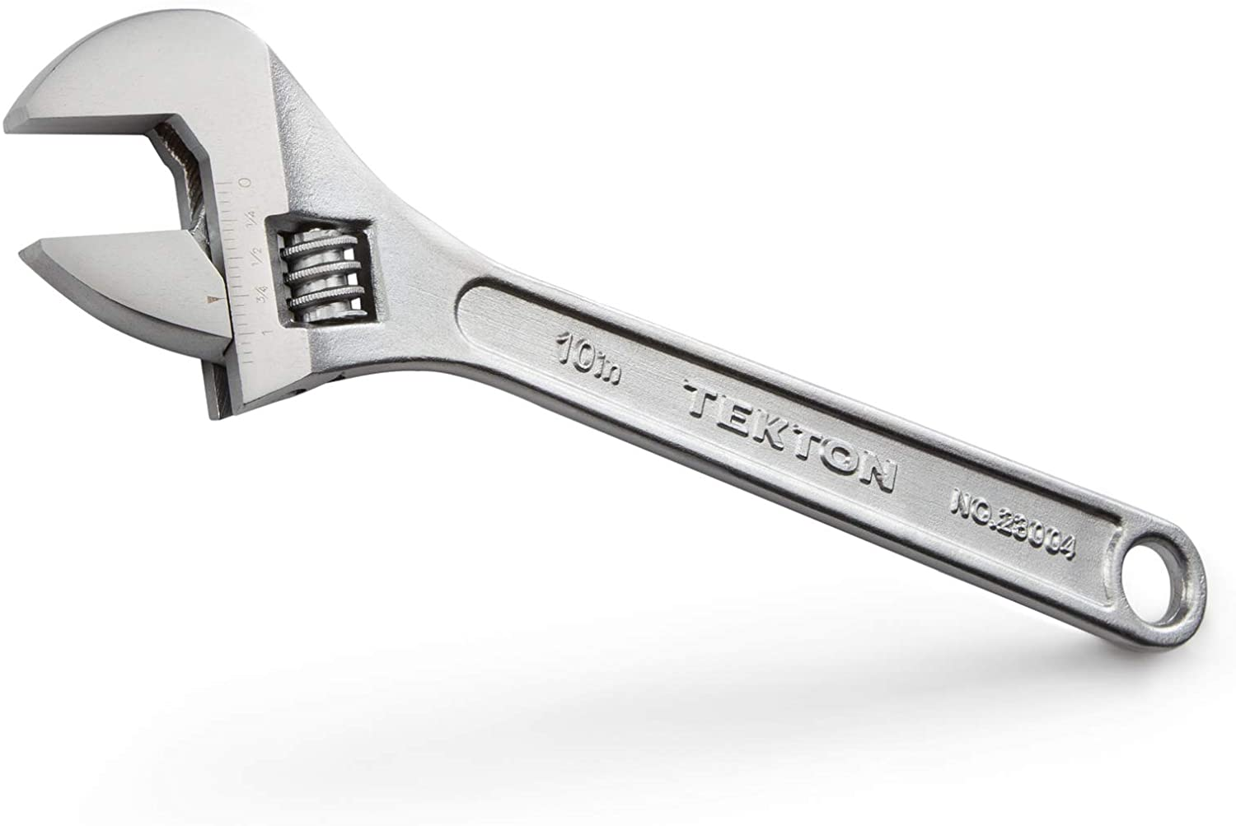
How to fix a Blockchain
Layer 1: change blockchain itself
e.g., Proof of Work vs Proof of Stake
Layer 2: change how blockchain is used
e.g., Plasma
e.g., Rollups
e.g., Sharding

Slide 6
Side-Chains (simplified)

Slide 7
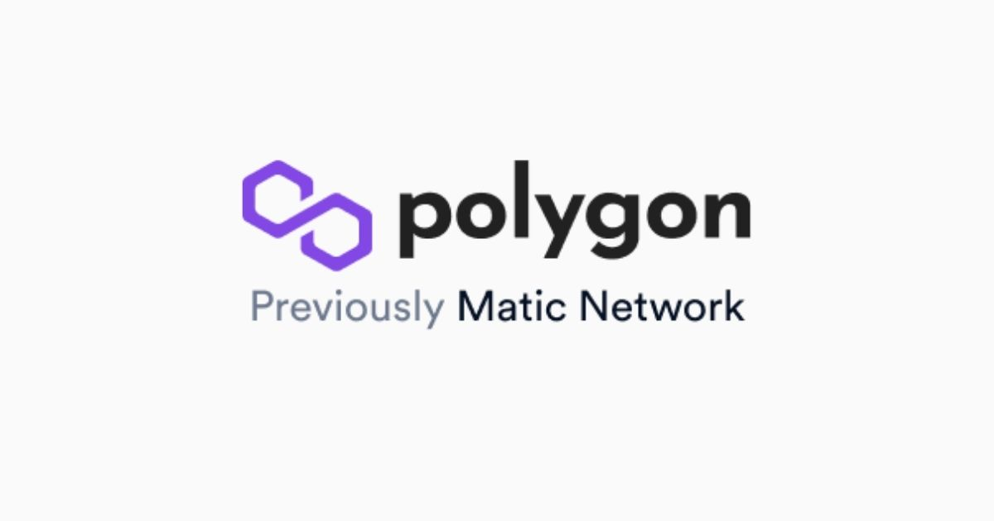

Slide 8
Subchains
I am the main chain …
I am lightly loaded because …
I am used mostly for reconciliation
Main chain
Child chain

Slide 9
Subchains
I am the main chain …
I am lightly loaded because …
I am a child chain …
I do most of the work
I am used mostly for reconciliation
I play by my own rules
Main chain
Child chain

Slide 10

Subchains
I am an agent!
Unlike passive blockchains, I am active
Main chain
Child chain

Slide 11
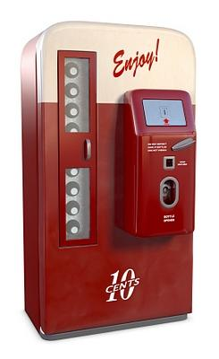
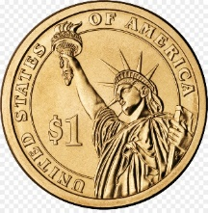
Subchains
I am a smart contract …
I create an asset …
Main chain
Child chain

Slide 12
Register Asset
Register that asset on child chain by creating contract
Main chain
Child chain

Slide 13
Move Asset
Move that asset from main chain to child chain
Main chain
Child chain

Slide 14
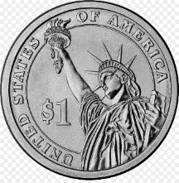
Move Asset
Move that asset on from main chain to child chain
Freeze asset on main chain
Main chain
Child chain

Slide 15
Move Asset
Move that asset on from main chain to child chain
Freeze asset on main chain
Main chain
Mint matching asset on child chain
Child chain

Slide 16
Transact on Subchain
Agent gives Bob Merkle proof of Alice →Bob
Main chain
Alice →Bob
Child chain

Slide 17
Transact on Subchain
Periodically publish Merkle root of all child chain txns on main chain
Main chain
Child chain

Slide 18
Transact on Subchain
Agent gives Carol Merkle proof of Bob→Carol
Main chain
Alice→Bob
Bob→Carol
Child chain

Slide 19
I’m Bob and here is proof I own that asset on child chain
Bob tries to cheat …
Alice→Bob
Main chain
Child chain

Slide 20
I’m Bob and here is proof I own that asset on child chain
Challenge Period
Alice→Bob
Main chain
Does anyone object to this?
(tick-tock)
Child chain

Slide 21
I’m Bob and here is proof I own that asset on child chain
Challenge Period
I’m Carol and here is a later proof I own that asset on child chain
Alice→Bob
Bob→Carol
Main chain
Does anyone object to this?
(tick-tock)
Child chain

Slide 22
Carol now owns asset repatriated to main chain
After Challenge Period
Alice→Bob
Bob→Carol
Main chain
Child chain

Slide 23
Advantages
Main chain has light load
Most transactions on specialized child chains
Less overhead than channels

Slide 24
Disadvantages
Must publish Merkle roots regularly
Long latency (5 business days) for challenges
Doesn’t work for assets without “owners”
Requires application-specific reasoning

Slide 25
Rollups (simplified)

Slide 26
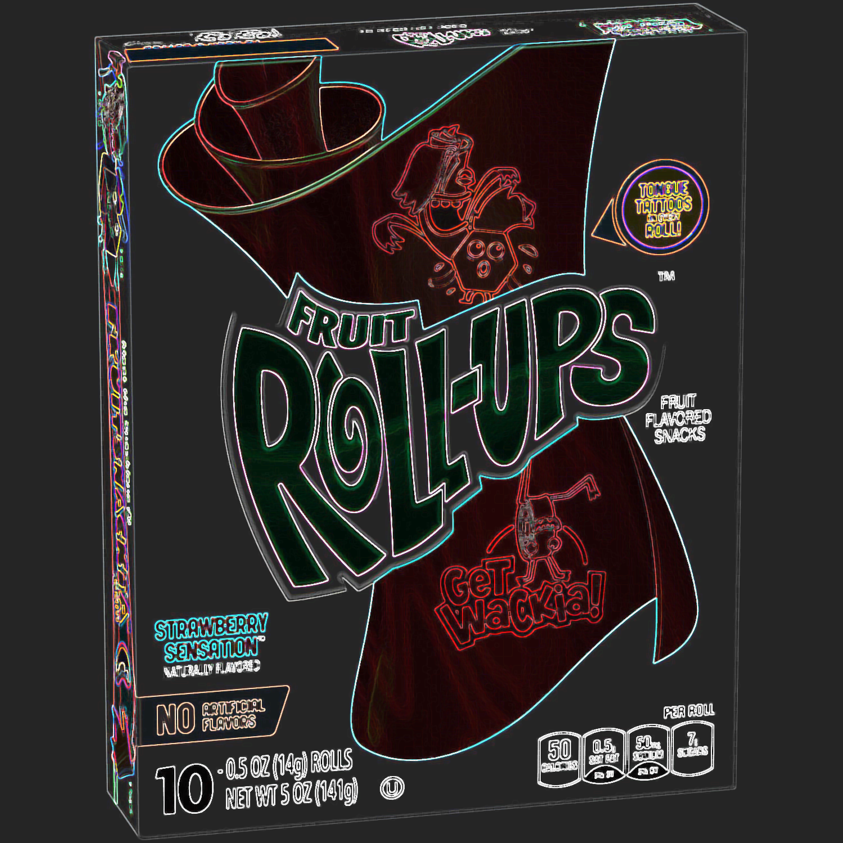
Motivation
Plasma & Channels move data & computation off-chain
Only works when assets have busybody “owners”
Rollups are hybrid:
Off-chain: computation & some data
On-chain: some data

Slide 27
On-Chain Contract
State Merkle root: 0xcafe1367
Maintains state root
Merkle tree root of txns
Rollup contract

Slide 28
On-Chain Contract
0xcafe1369
_{Alice:}
₅₀
_{Bob:}
₁₀₀
_{Carol:}
₁₅₀
_{David:}
₂₀₀
Rollup contract
Account balances, contract state, …

Slide 29
On-Chain Contract
0xcafe1369
(Tree not actually stored on chain, but can be recomputed from chain data)
_{Alice:}
₅₀
_{Bob:}
₁₀₀
_{Carol:}
₁₅₀
_{David:}
₂₀₀
Rollup contract
Account balances, contract state, …

Slide 30
On-Chain Contract
I’m Alice and here is a batch of transactions in highly-compressed form
Old root | 0xcafe1369
New root | 0x12345678
Alice→Bob | 10
Alice→Carol | 20
Bob→Carol | 10

Slide 31
On-Chain Contract
Old root | 0xcafe1369
New root | 0x12345678
Alice→Bob | 10
Alice→Carol | 20
Bob→Carol | 10
0xcafe1369
New transactions
_{Alice:}
₅₀
_{Bob:}
₁₀₀
_{Carol:}
₁₅₀
_{David:}
₂₀₀
Account balances,
contract state, …
Rollup contract

Slide 32
On-Chain Contract
Old root | 0xcafe1369
New root | 0x12345678
Alice→Bob | 10
Alice→Carol | 20
Bob→Carol | 10
0xcafe1369
(Tree not actually stored on chain, but can be recomputed from chain data)
New transactions
_{Alice:}
₅₀
_{Bob:}
₁₀₀
_{Carol:}
₁₅₀
_{David:}
₂₀₀
Account balances,
contract state, …
Rollup contract

Slide 33
How do I know Alice is telling the truth?
On-Chain Contract
Old root | 0xcafe1369
New root | 0x12345678
Alice→Bob | 10
Alice→Carol | 20
Bob→Carol | 10

Slide 34
Solution 1: Optimistic Rollups (simplified)

Slide 35


Slide 36
Optimistic Rollups
Old root | 0xcafe1369
New root | 0x12345678
Alice→Bob | 10
Alice→Carol | 20
Bob→Carol | 10
0xcafe1369
I’m Bob & I can prove that Alice lied!
New transactions
_{Alice:}
₅₀
_{Bob:}
₁₀₀
_{Carol:}
₁₅₀
_{David:}
₂₀₀
Account balances, contract state, …
Rollup contract

Slide 37
Optimistic Rollups
OK, reverting bad block (& any later blocks)
Old root | 0xcafe1369
New root | 0x12345678
Alice→Bob | 10
Alice→Carol | 20
Bob→Carol | 10
0xcafe1369
I’m Bob & I can prove that Alice lied!
New transactions
_{Alice:}
₅₀
_{Bob:}
₁₀₀
_{Carol:}
₁₅₀
_{David:}
₂₀₀
Account balances, contract state, …
Rollup contract

Slide 38
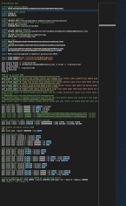
How Challenges Work
I’m Alice & my rollup is honest!
I’m Bob & I can prove that Alice lied!
Disputed code
Let’s just replay the transactions!
That’s expensive

Slide 39
How Challenges Work
Which half do you dispute?
This half
Disputed code

Slide 40
How Challenges Work
Which half do you dispute?
This half
Disputed code

Slide 41
How Challenges Work
This is easy to check on-chain!
Disputed instruction

Slide 42
Moving Assets
L2
I want to use this asset in a rollup
L1

Slide 43
Moving Assets Up is Easy
L2
Minted
I want to use this asset in a rollup
Bridge Contract
L1
Frozen

Slide 44

Moving Assets Down is Slow
L2
Burned
Challenge
period
I want my asset back
L1
Unfrozen

Slide 45
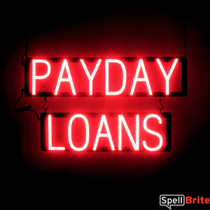
Liquidity providers
L2
I will buy your L2 asset at a discount
I need my asset now!
I have cecked for myself it’s valid
L1

Slide 46
Solution 2: ZK Rollups (simplified)

Slide 47
ZK Rollups
I’m Alice and here is a batch along with a validity proof that the new root is correct
Old root | 0xcafe1369
New root | 0x12345678
Alice→Bob | 10
Alice→Carol | 20
Bob→Carol | 10
ZK proof | (lots of bits)
This proof is slow to produce but quick to check

Slide 48

ZK-Rollup L1
Ethereum
chain
L1 contracts
L1 EVM

Slide 49
ZK-Rollup L2
L2 state
state root
txn root
State & Txn roots stored on L1
sequencer
state
tree
txn
tree
L2 EVM

Slide 50
Alice submits txn to sequencer
Thank you, please wait
I’m Alice and here is an off-chain transaction
sequencer
Alice→Bob | 10

Slide 51
Sequencer batches txns and sends to L2
Brrr!
Here is a batch of txns
L2 EVM
Alice→Bob | 10
Alice→Carol | 20
Bob→Carol | 10
sequencer

Slide 52
L2 ZK-EVM updates L2 state
L2 state
Must update L2 state
new root
new root
old root
old root
state
tree
txn
tree
state
tree
txn
tree
L2 EVM

Slide 53
Sequencer batches txns and sends to L1
Here are new roots + proof of changes
Validity proof
Old state root
New state root
Old txn root
New txn root
sequencer
L1
contract

Slide 54
Moving Assets Up is Easy
ZK-L2
Minted
I want to use this asset in a rollup
Bridge Contract
L1
Frozen

Slide 55
Moving Assets Down is Quick
ZK-L2
Burned
No
Challenge
period
I need my asset now!
L1
Unfrozen

Slide 56
Comparison
Property | Optimistic Rollups | ZK Rollups
Gas cost / batch | ~40 K | ~500 K
Optimistic:
Just changes state root
ZK Proof:
Verifying ZK proof is work

Slide 57
Comparison
Property | Optimistic Rollups | ZK Rollups
Withdrawal | ~1 week | Almost Instant
Optimistic:
Leave time for challenge
ZK Proof:
Fast: just wait for next batch

Slide 58
Comparison
Property | Optimistic Rollups | ZK Rollups
Complexity | Low | High
Optimistic:
Low: nothing special
ZK Proof:
High: complex, untried tech

Slide 59
Comparison
Property | Optimistic Rollups | ZK Rollups
Generality | Easy | Hard
Optimistic:
General-purpose rollups almost ready
ZK Proof:
General-purpose ZK is still research

Slide 60
Comparison
Property | Optimistic Rollups | ZK Rollups
On-chain gas costs | Higher | Lower
Optimistic:
Higher: need to store more info
ZK Proof:
Lower: heavy lifting done off-chain

Slide 61
Comparison
Property | Optimistic Rollups | ZK Rollups
Off-chain costs | Lower | higher
Optimistic:
Lower, but must still replay computation
ZK Proof:
Higher, ~1000 slower than replay

Slide 62
Summary
Property | Optimistic Rollups | ZK Rollups
Gas cost / batch | ~40 K | ~500 K
Withdrawal | ~1 week | Almost Instant
Complexity | Low | High
Generality | Easy | Hard
On-chain gas costs | Higher | Lower
Off-chain costs | Lower | higher

Slide 63
Sharding (simplified)

Slide 64
Congestion Problem
Every txn competes with every other
Lots of combined data
Instead of going off-chain …
Make more chains!
Idea: break up blockchain and divide work

Slide 65
I am the beacon chain …
Subchains
I am lightly loaded because …
I am used mostly for coordination
Beacon chain

Slide 66
Subchains
Shard Chains have Independent States
Beacon chain
I am Shard 64
I am Shard k …
I am Shard 2
I am Shard 1

Slide 67
Validators
Assigned randomly to shards
Requires PoS
Shard 64
Shard 1

Slide 68
Validators
Assigned randomly to shards
Question: why at random?
Requires PoS
Shard 64
Shard 1

Slide 69
Validators
Assigned randomly to shards
Answer: this
Requires PoS
Shard 64
Shard 1

Slide 70
Cross-Shard Communication
Can communicate via Merkle proofs - plus either challenges or ZK proofs
Beacon chain

Slide 71
Advantages
Computation split among shards
Data split among shards
Normal users can run nodes
Most transactions likely independent

Slide 72
Disadvantages
Easier to attack smaller committees
Enough to corrupt one shard!
Cross-shard coordination complicated
Hard to implement (work in progress)

Slide 73
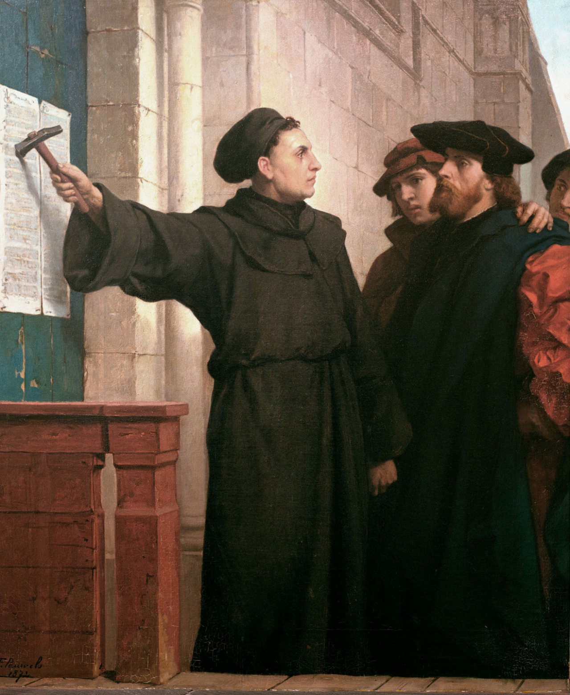
Ideas we covered in this lecture
Scalability issues in Ethereum
Side chains
Rollups
Sharding

Slide 74
